Slide 1
Smart Home:
If you connect it, protect it!

Slide 2



Hello EC545!
Team :
Harshit Agrawal M.S. Computer Engineering
BU ECE
harshit@bu.edu
Román Vélez-Alicea M.S. Computer Engineering
BU ECE
rgva@bu.edu
Zhiqing Wang M.Eng System Engineering
BU ECE
joeyw@bu.edu
Notes:
Welcome to our presentation
Introduce by first name
Carry on

Slide 3
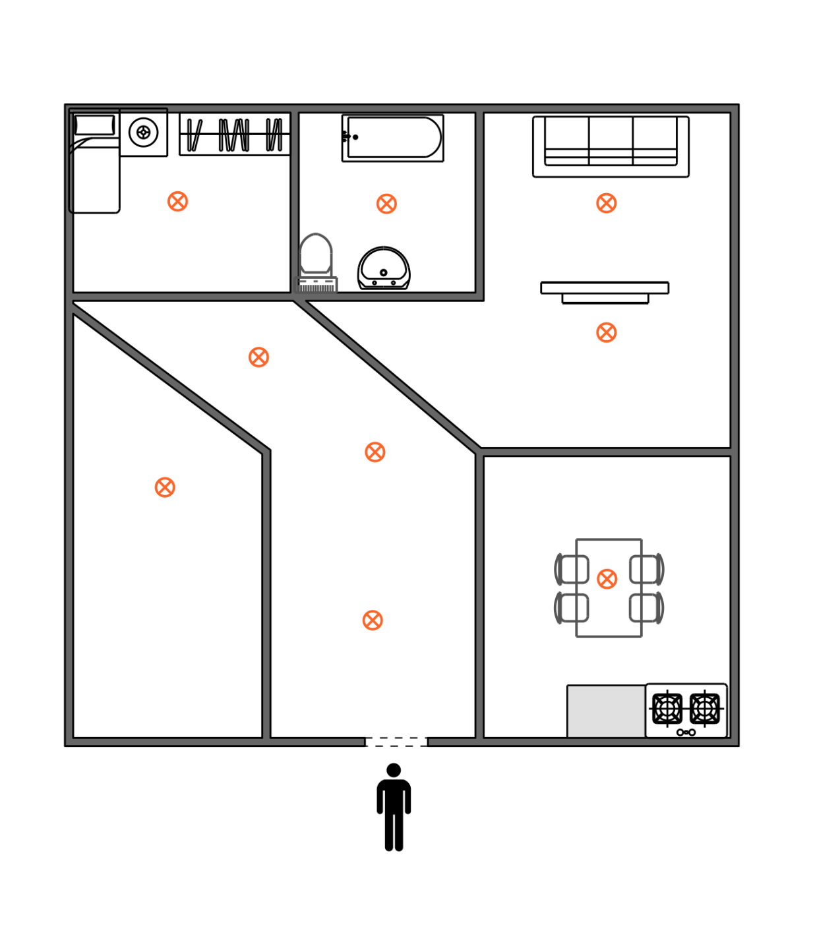
Motivation
Model some aspects of a smart home system, and expose its vulnerabilities.
Showcase a variety of technologies that a computer-savvy burglar might use to gain access to the home.
Demonstrate core concepts learned in class.
Sensors and Actuators
Temporal Logic Specification
UPPAAL
Scheduling (Preemptive Priority-Based)
Security
Fig. 1 - The Home

Slide 4
Smart Home Specifications

Slide 5
Previous Specification | Current Specification | Reason for Change (if any) | Current Specification Achieved?
When person occupies a room, light will not turn off unless via WiFi control. | No change. | (N/A) | Yes
Can distinct between homeowner and intruder, and trigger a defence mode. | RFID door access locks out after three failed attempts, triggering a defence mode. | Scope narrowed down. | Yes
Two Arduinos - Automated Systems Control (MEGA), WiFi Control (WiFi Uno) which can override commands from the MEGA. | Three Arduinos - Automated Systems Control (MEGA), WiFi Control (WiFi Uno), Door Access (Uno). | Easier implementation, MEGA board GPIOs oversaturated. | Yes
Defence strategy against intruder in different cases: owner absent/present. | Not implemented. | Revised scope, simplification. | N/A
When no one is in the house, all lights turn off after 5 minutes of no input. | Not implemented. | Revised scope, simplification. | N/A

Slide 6
Attack Vector Specifications

Slide 7
Previous Specification | Current Specification | Reason for Change (if any) | Current Specification Achieved?
Smart lighting controlled via RF, attack focused on jamming signal | Smart lighting controlled via Wifi, attack focused on deauth and intrusion | RF relay never arrived. | Yes
RFID Door Access, attack focused on using Proxmark3 to clone cards. | No change. | (N/A) | Yes
IR controlled lights, attack focused on replicating signals via FlipperZero | Proximity sensor/WiFi controlled lights, attack focused on control over WiFi host | Revised scope, practicality concerns. | Yes
Arduino MEGA taking input from Wifi Arduino, deauthentication through ALFA WiFi chip / ESP8266 in promiscuous mode. | No change. | (N/A) | Yes
Attack strategy against victim in case of: owner absent/owner present | Not implemented. | Revised scope, simplification. | N/A

Slide 8
Circuit Design

Slide 9
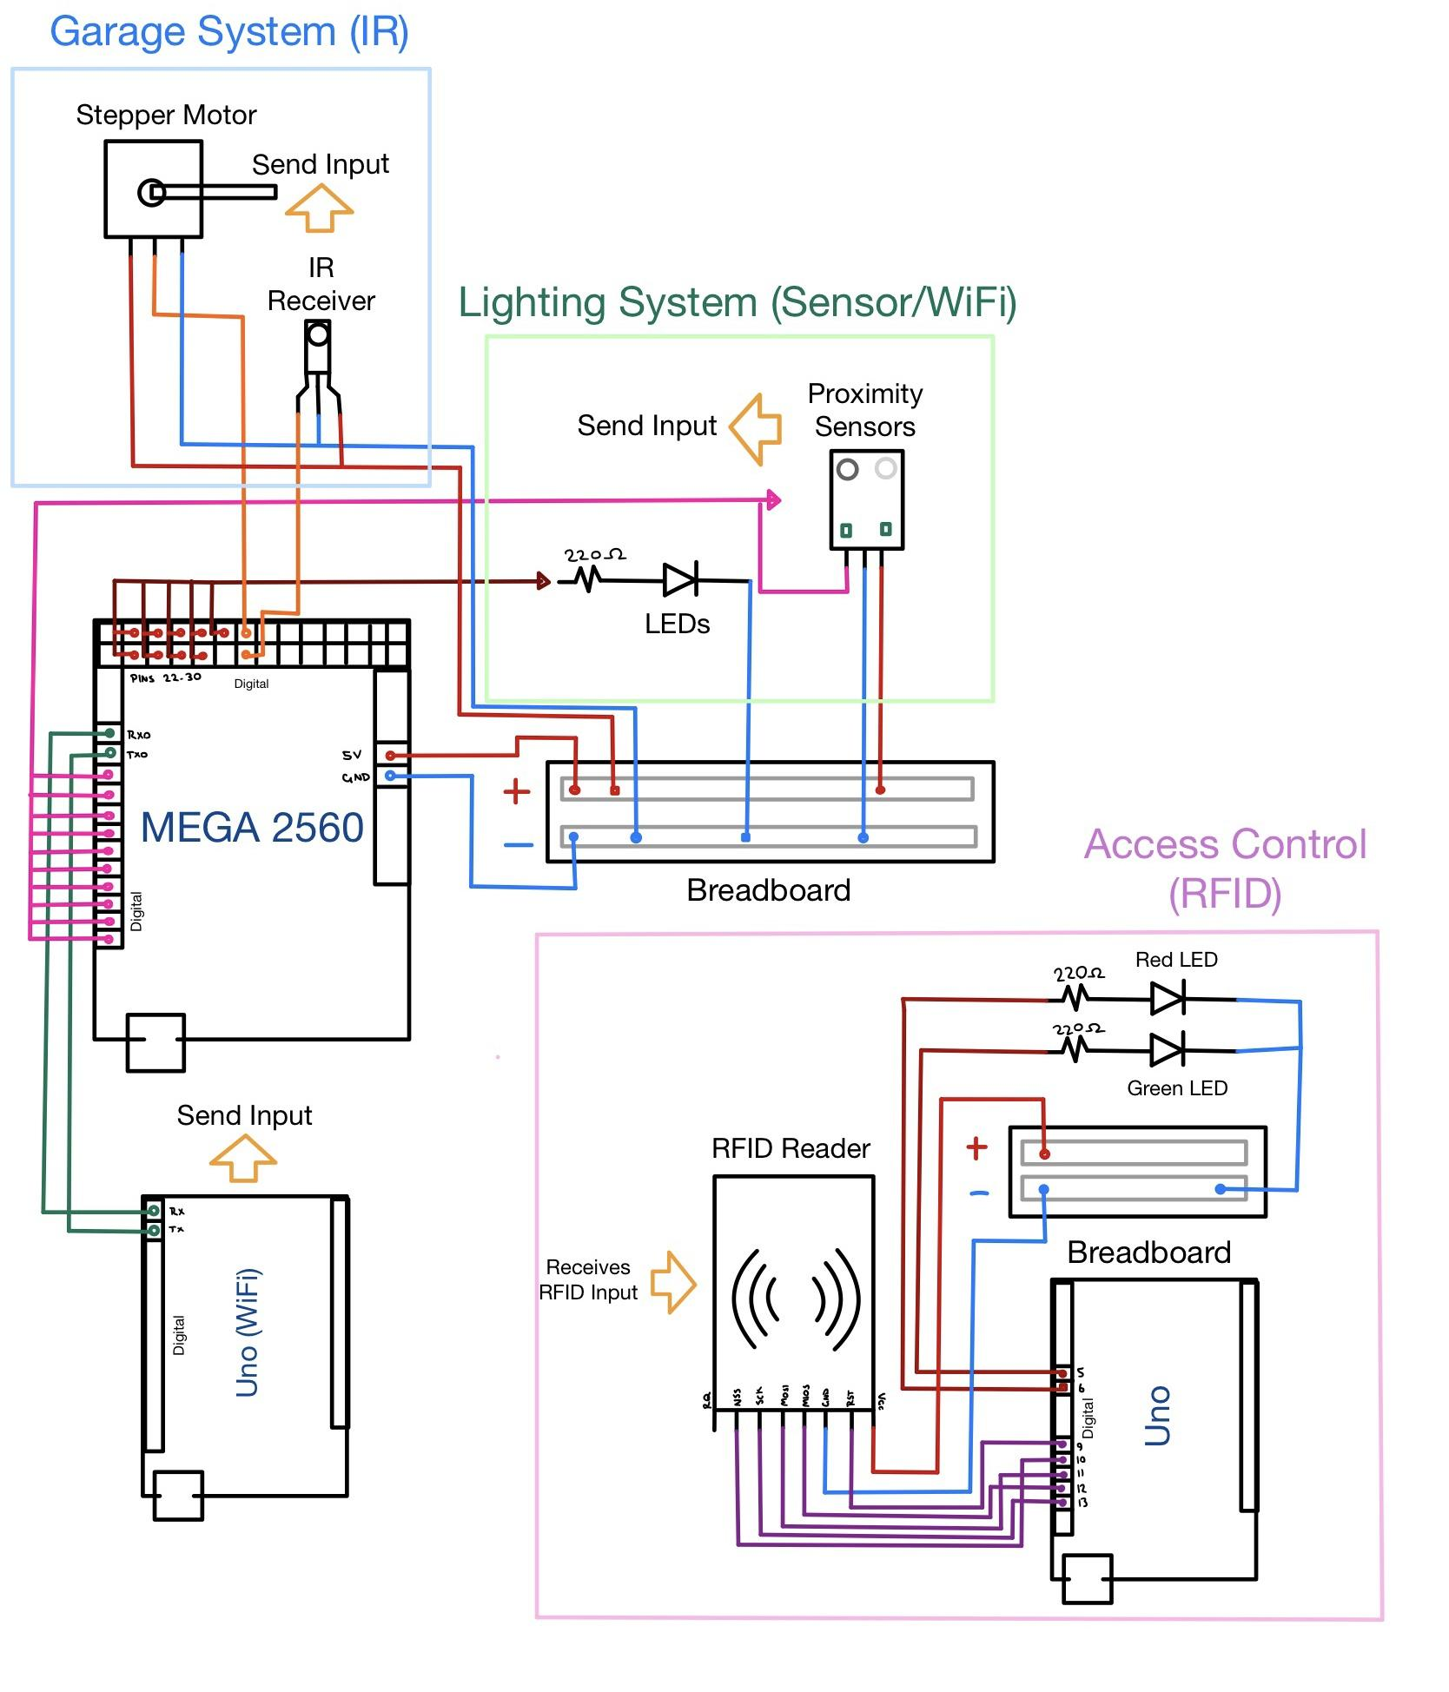

Slide 10
Recorded Demo

Slide 11

RFID Access

Slide 12
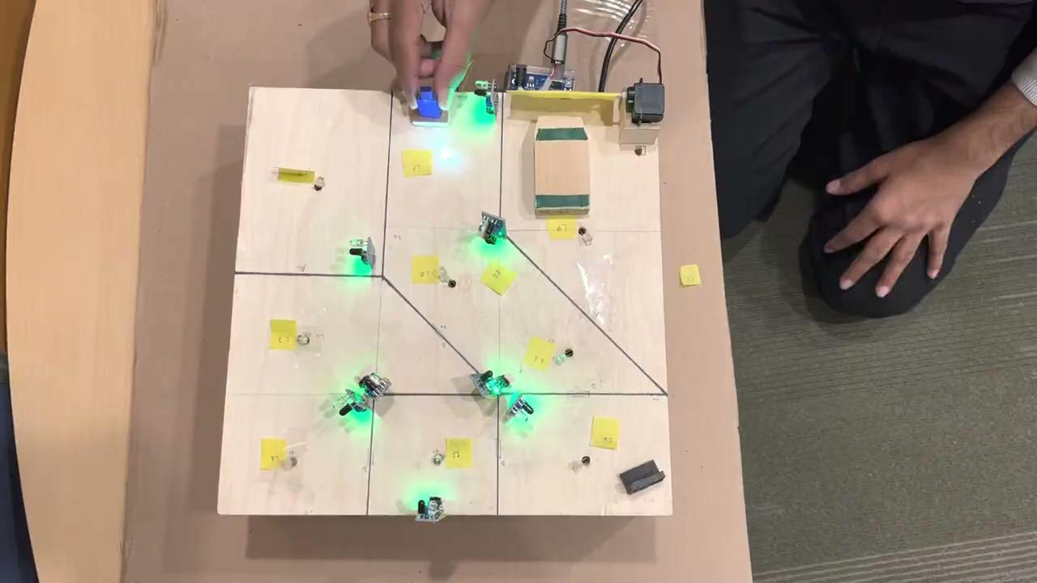
Occupancy-based lighting

Slide 13
Wifi-controlled lighting

Slide 14
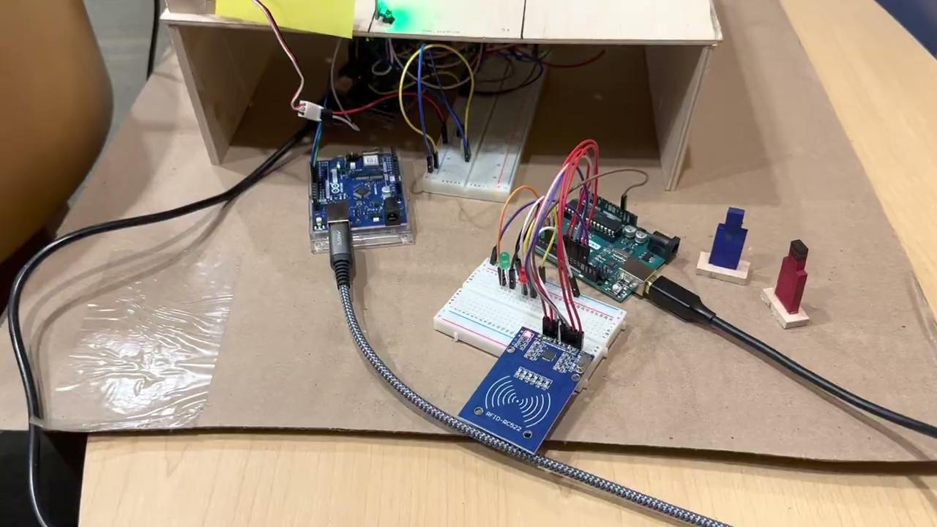
RFID Clone Attack

Slide 15
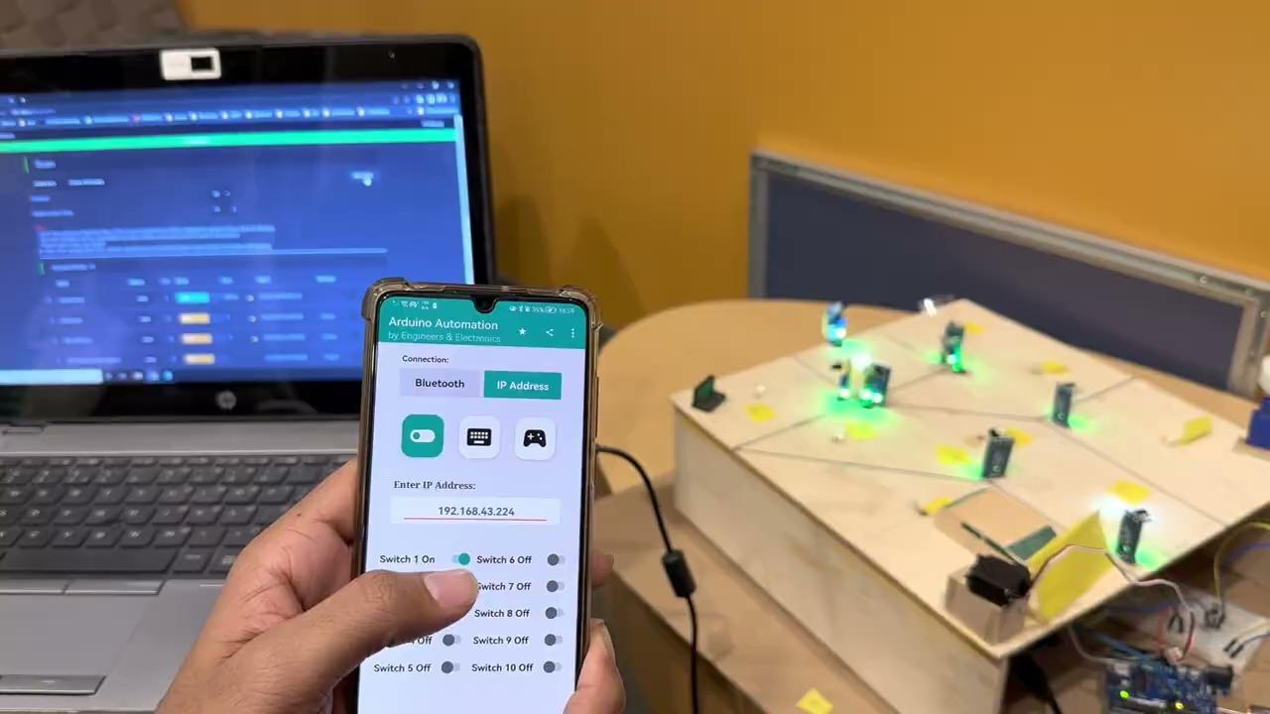
Deauthentication attack

Slide 16
Attacker gained control of lighting system

Slide 17
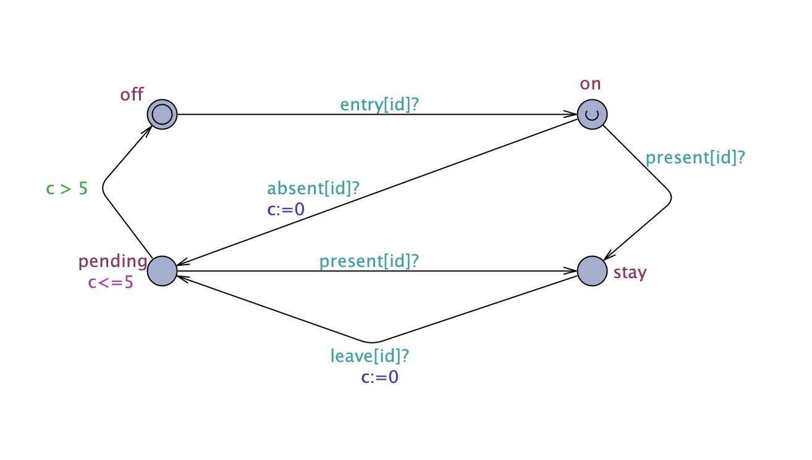
Analysis
When a person is no longer present in current room(i.e. Presented in another room)
The light will automatically turned off.
This feature has been achieved by the house model.

Slide 18
Thank you! Questions?

Slide 19
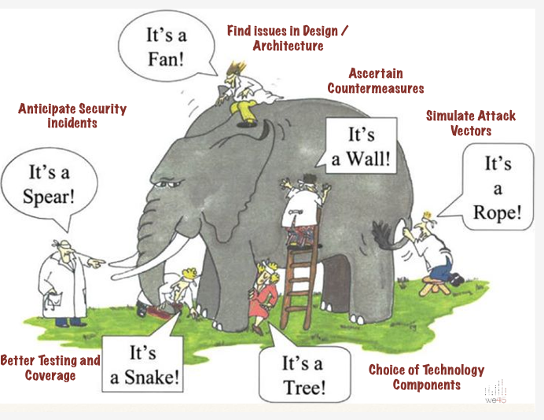
Analysis

Slide 20
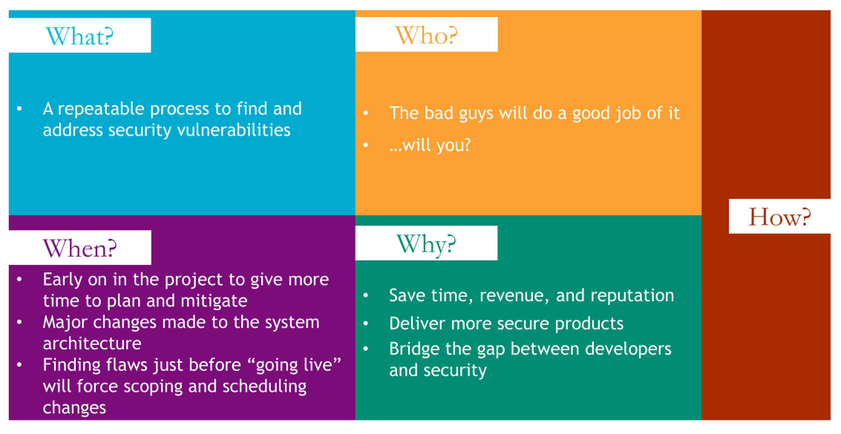

Slide 21
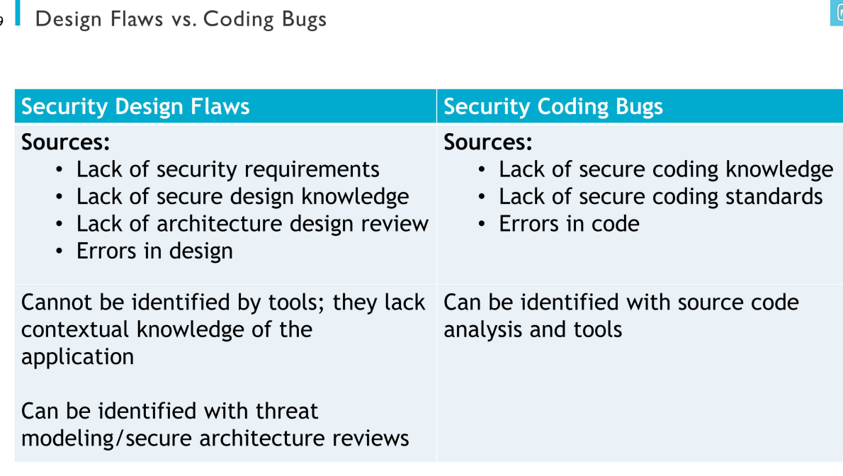

Slide 22
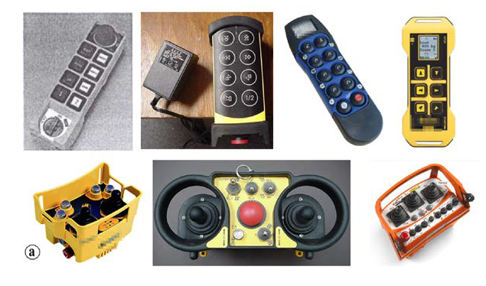
Remote Controllers
Image source: FCC documentation
Notes:
User carries a key fob that contains a short range radio transmitter and receiver.
User presses a button on the key fob to lock/unlock the device.
Once the vehicle authenticates the key fob, the vehicle processes the instruction.
RF remote controllers are widely used in the manufacturing, construction, and transportation industries.
Cranes, drills, and miners, among others, are commonly equipped with radio controllers for flexible operation. Unfortunately, we found a complete lack of security in the design of these devices, leaving millions of vulnerable units installed on heavy industrial machinery open to local and remote attacks, unless patched promptly.
In industrial environments, this represents a significant problem, because of the safety-critical conditions and the long life spans and high replacement costs of the devices.

Slide 23
Replay Attack
A network security attack in which the attacker delays or repeats data transmission between the user and the receiver.
Misdirects the receiver into doing what the attacker wants.
If no wireless security mechanism is used, simply replaying the signal will result in the transmission being accepted by the controller receiver.

Slide 24
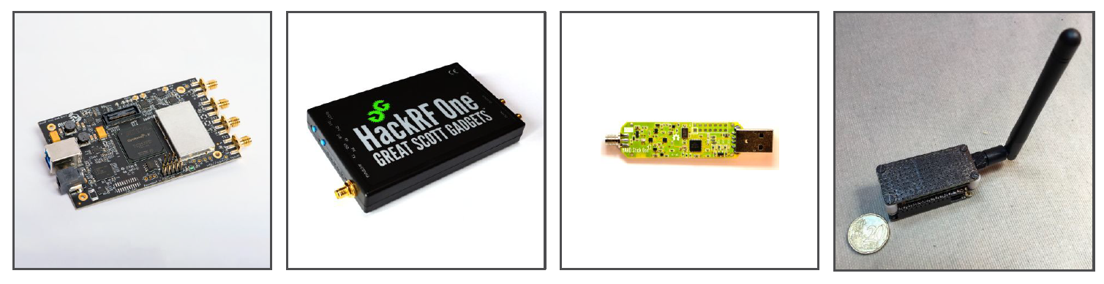
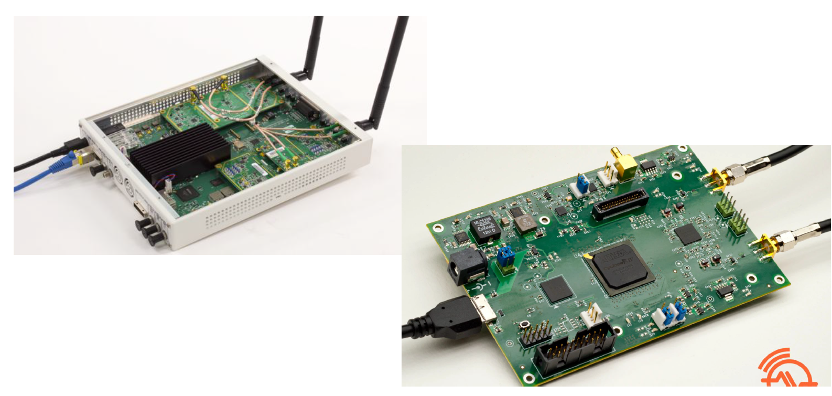
SDR
Notes:
HACKRF
• A Software Defined Radio peripheral capable of transmission or reception of radio signals from 1 MHz to 6 GHz.
• One of the best peripherals that are out there
• Can receive and transmit
• Cost: 300$
RTL-SDR
RTL-SDR is a very cheap software defined radio that uses a DVB-T TV tuner dongle based on the RTL2832U chipset.
Essentially, this means that a cheap $20 TV tuner USB dongle with the RTL2832U chip can be used as a computer based SDR.
Drawback – receive only. But still great for analysis!
Cost: 20$

Slide 25
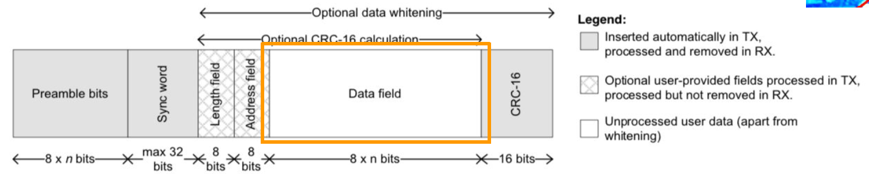
Packet Format
Preamble: used to synchronize a data transmission
Indicates the end of header information.
Sync word: start of data
Image source: Texas Instruments

Slide 26
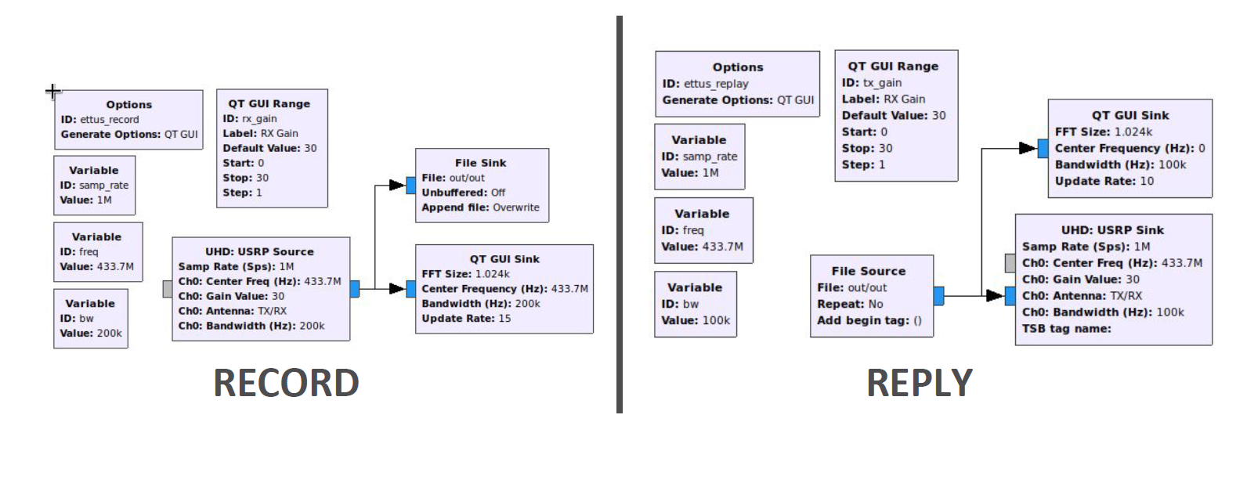
Replay Attack (GNU radio)
Notes:
GNU Radio is a framework that enables users to design, simulate, and deploy highly capable real-world radio systems.
So basically to transmit/ receive any signal we have this pattern:
Source --> FILTERS --> CONVERTOR -->DEMODULATORS -->Audio/File Sink
Here you can see an simple example of replay attack using gnuradio blocks, which is drop/drag… no need to code DSP

Slide 27
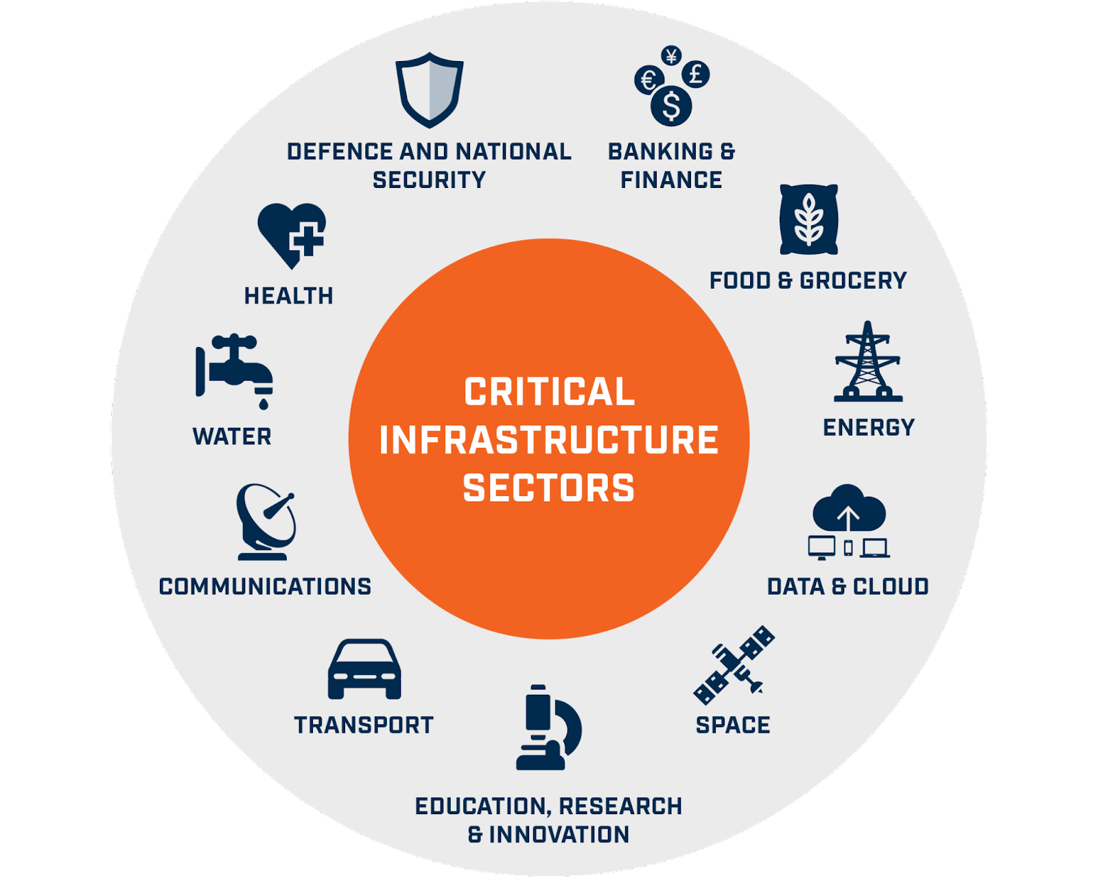
Secure Communication & Integrity Management of ICS
Electricity: Power Generation and Power Distribution.
Petroleum/Natural Gas: Exploration, Extraction, Pipeline, Production.
Wastewater: Treatment/Purification.
Transportation:
Aviation: Traffic Control, Aviation Vehicles.
Rail: Traffic Control (BackOffice, Wayside, and Onboard), Other non-traffic, onboard systems.
Maritime: Traffic Control, Onboard Shipping Control systems.
Automotive: Traffic Control, Individual Vehicle Control systems.
Manufacturing
Mining
Notes:
Systems which are typically considered as Industrial Control Systems, usually manage mission and/or safety critical types of systems, including critical infrastructure systems
These systems come under a variety of names:
Industrial Control Systems (ICS).
• Operational Technology (OT).
• Supervisory Control and Data Acquisition (SCADA).
• Programmable Logic Controllers (PLC).
• Proportional-Integral-Derivative (PID).
Challenges:
• Updating the security credentials in automotive vehicles would be inordinately costly and practically impossible in all cases given that some vehicles may never visit an authorized service center to connect to the OEM backend server.
• Remote updating of security credentials of high-security military installations is usually prohibited and done locally.
Making the overall security credential update process inordinately costly.
• Remote updating of security credentials of space systems is problematic both for reasons of security and practicality Availability for many of these systems must be at or close to 100%. Meaning, the systems they control must remain online 24-hours a day, 365-days a year, without interruption. Systems that fall under this category usually have double or triple redundancy systems, but if there is a security breach, depending upon the redundancy is achieved, it may easily affect all of the redundant systems as well.
These systems, particularly those protecting critical infrastructure, are considered to be excellent targets by potential attackers. A successful attack on such a system can incur a huge loss to both a country and its economy.

Slide 28
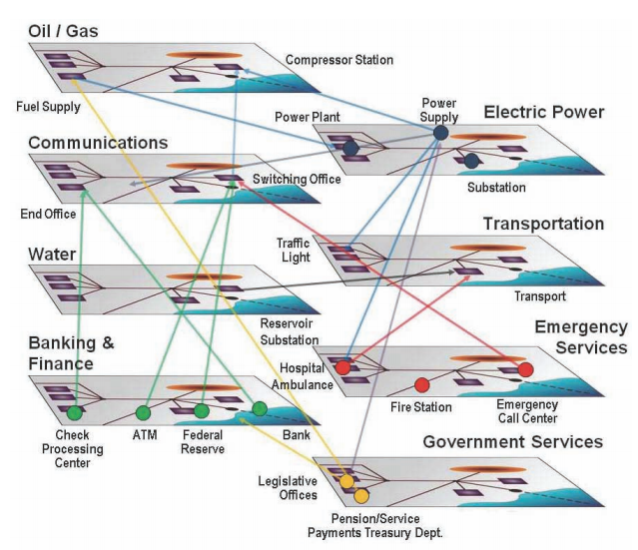
A Conceptual Illustration Interconnection within Critical Infrastructure
Notes:
Because of the ubiquitous dependence of society on the electrical power system, its vulnerability to an EMP attack, coupled with the EMP’s particular damage mechanisms, creates the possibility of long-term, catastrophic consequences. A single EMP attack may seriously degrade or shut down a large part of the electric power grid in the geographic area of EMP exposure effectively instantaneously. There is also a possibility of functional collapse of grids beyond the exposed area, as electrical effects propagate from one region to another.
Various lists are in circulation that identify the critical infrastructures. Such as  Electric power  Telecommunications  Banking and finance  Petroleum and natural gas  Transportation  Food  Water  Emergency services  Space  Government
The separation of these infrastructures into different domains tends to obscure the real interdependencies that sustain the effectiveness and daily operation of each one.
As a simple example, the telecommunications infrastructure requires power that is delivered by the power infrastructure. If power delivery is disrupted by disturbances in the power grid, telecommunication substations will run for a while on reserve battery power but would then need to switch to reserve backup generators (if they have them).
The generator’s operation would rely on fuel, first from on-site storage and then conveyed to a central distribution point by the energy distribution infrastructure and delivered to the telecommunications substation by the transportation infrastructure and paid for by the components of the financial infrastructure. The technicians who show up, through the transportation infrastructure, to make repairs would not do so unless they have been sustained by the food and water delivery infrastructures, and so forth.
The complex interdependence between elements within each infrastructure can be understood here…
.

Slide 29
How were the concepts (listed in Motivations) were applied in our design
E.G. Occupancy-based lighting priority of sensor input over WiFi connection
Photoelectric proximity sensors were used to detect the presence of person in room. Hence trigger the lights to turn on/off correspondingly.

Slide 30
What happened?

Slide 31
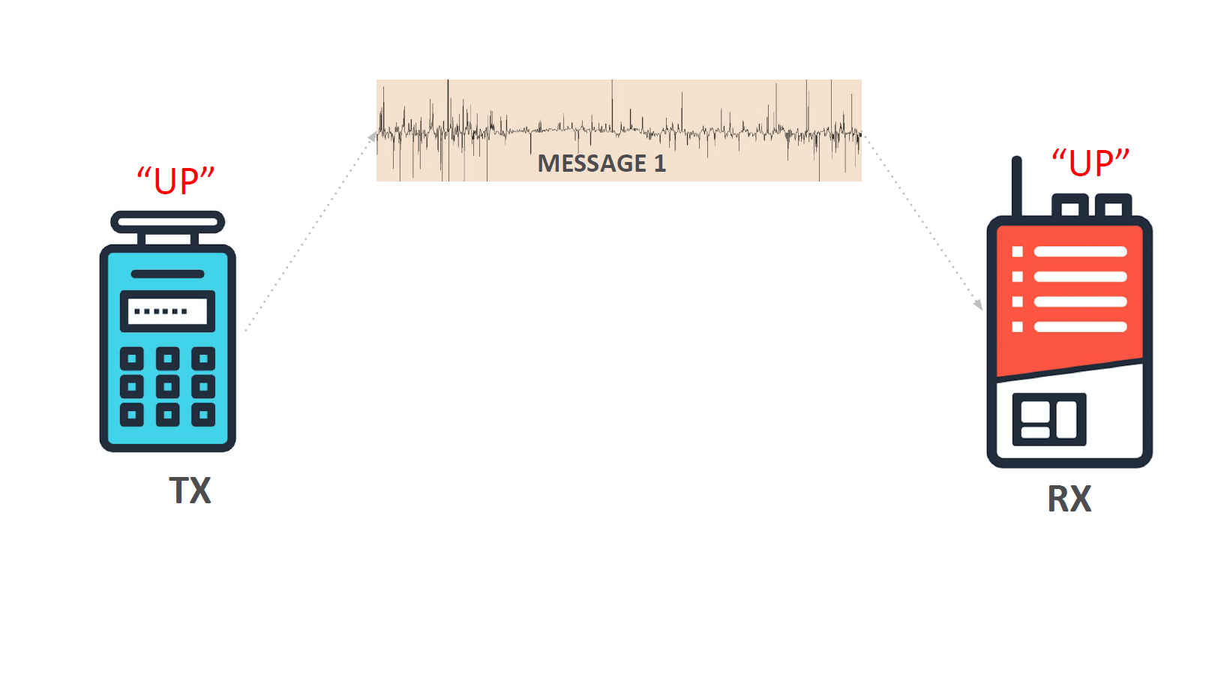

Slide 32
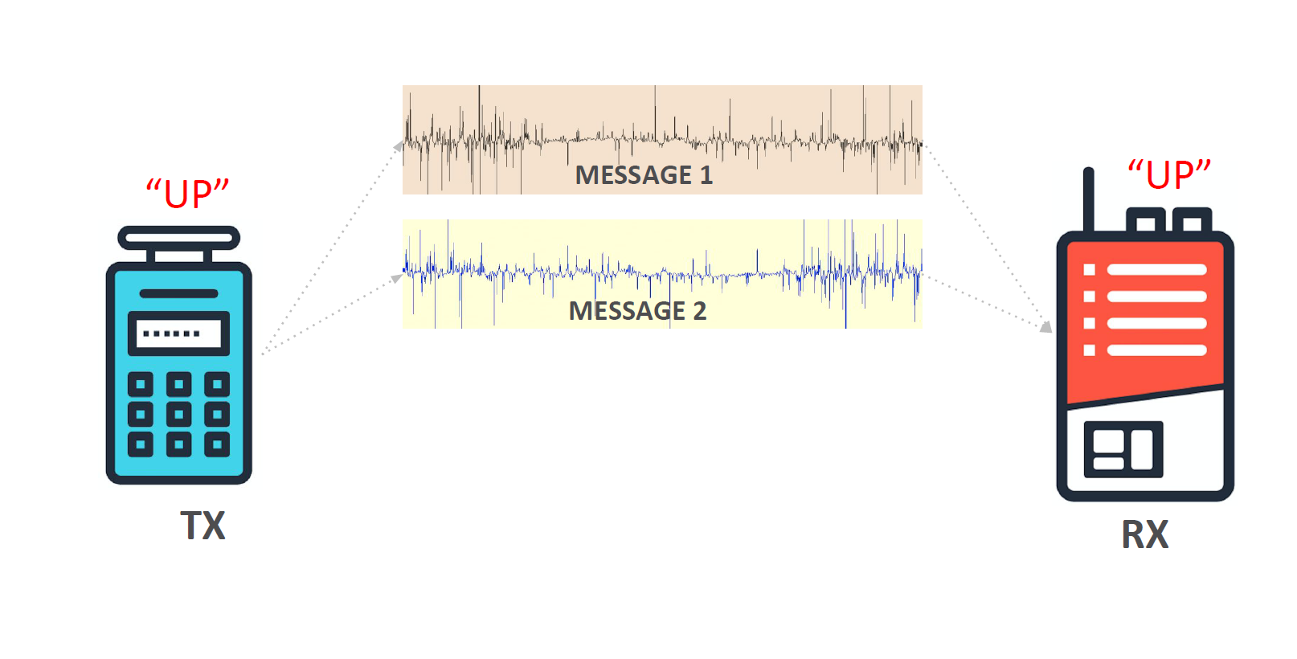

Slide 33
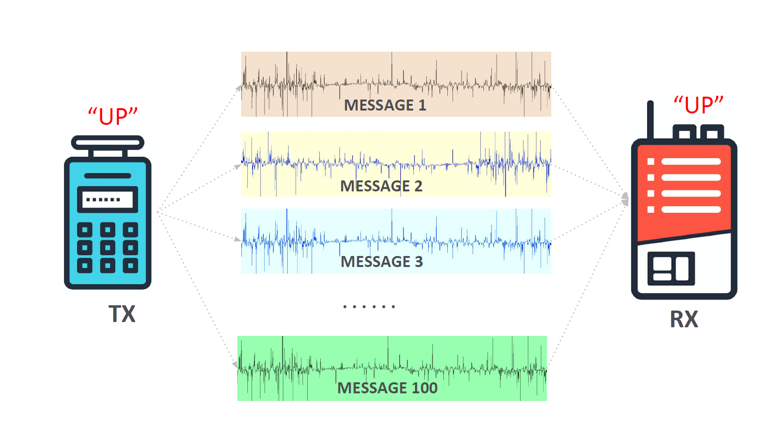

Slide 34
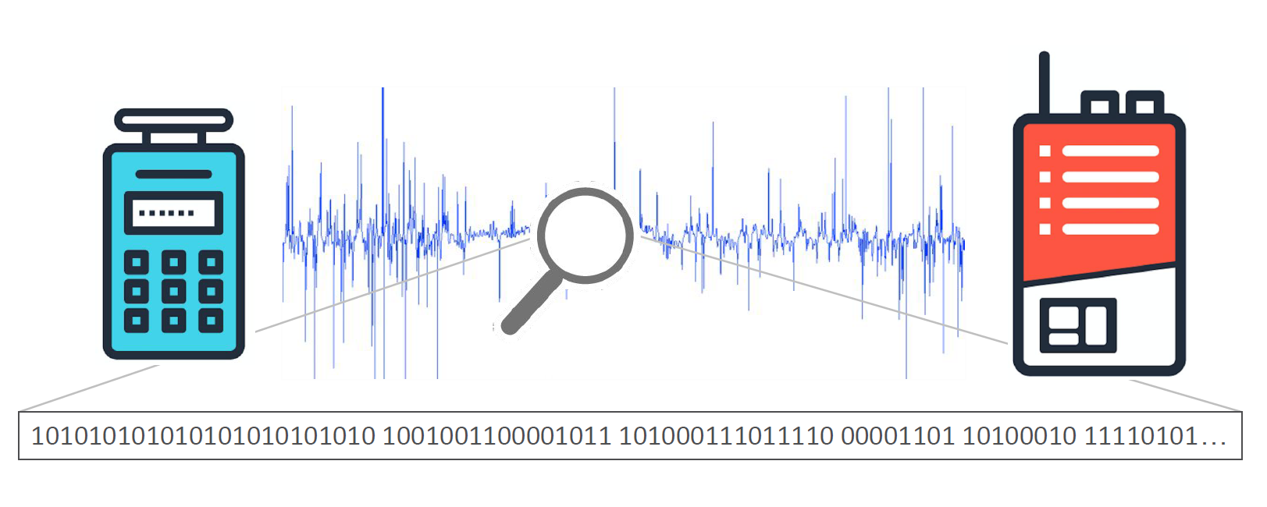


Arbitrary Command Execution
Difficulty:-
Cost:-

Slide 35
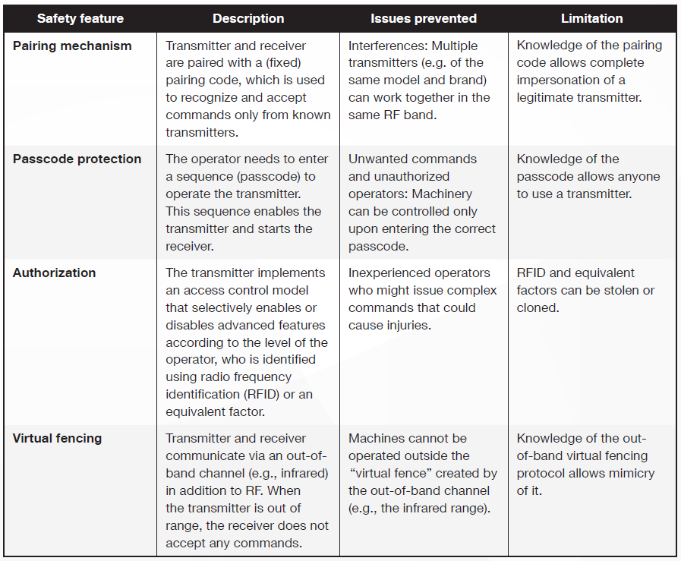

Slide 36
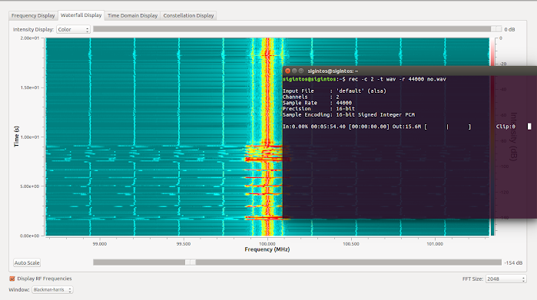
Live FM Broadcast
Notes:
With simple implementation of FM transmission on GNUradio one can easily broadcast live
rec -c 2 -t wav -r 44000 no.wav
SigintOS-> FM transmit (HackRF)

Slide 37
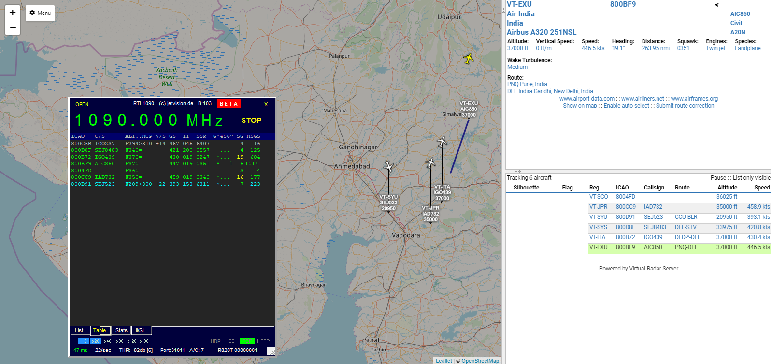
Plane Tracking
Notes:
(ADS–B) is a surveillance technology in which an aircraft determines its position via satellite navigation and periodically broadcasts it, enabling it to be tracked. This signals can be tracked using low-cost sdr like RTL. in this example I am using rtl1090 and virtual radar to track planes

Slide 38
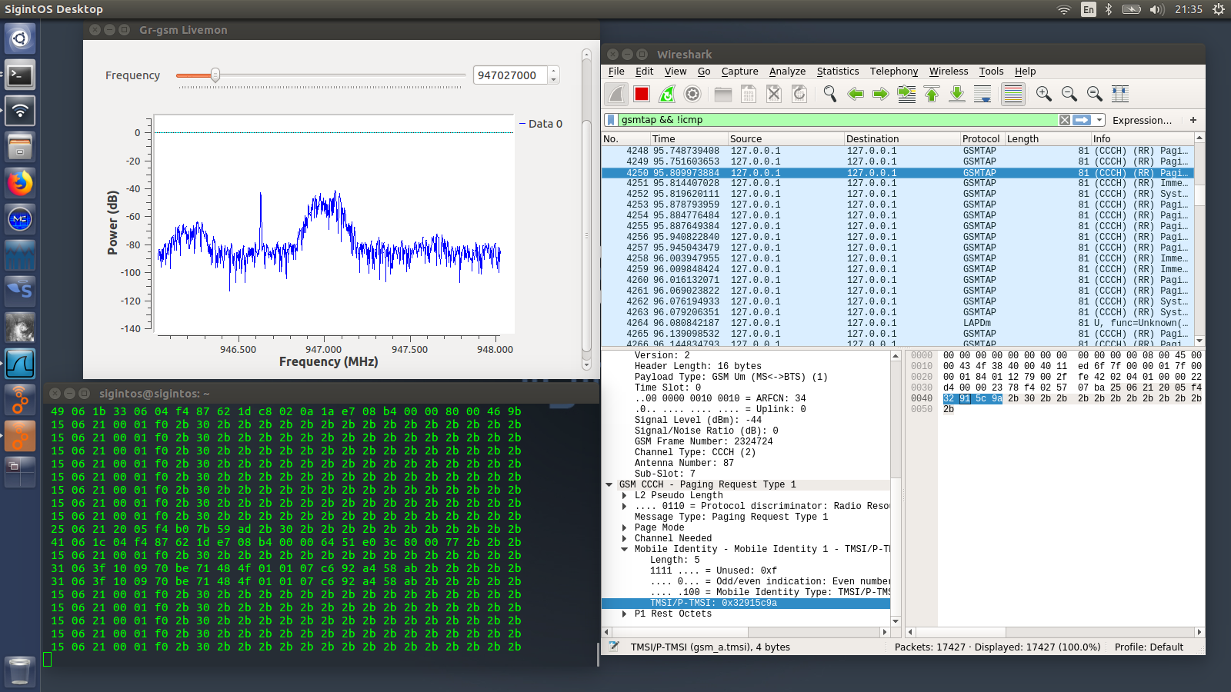
IMSI Catcher
Notes:
Using Gr-gsm, and kalibrate command we can listen to IMSI number and further decrypt the A3/A5 algorithm to listen into calls and message
How Does an IMSI Catcher Locate My Identity?
Every mobile phone has an IMSI (which means International Mobile Subscriber Identity) number. This number is unique to every SIM card. This number is shown once your mobile phone is connected to an IMSI Catcher. The police can determine your identity easily once they have this unique number. There is no way you cannot be a victim except you are not in an area with the IMSI catcher network.

Slide 39
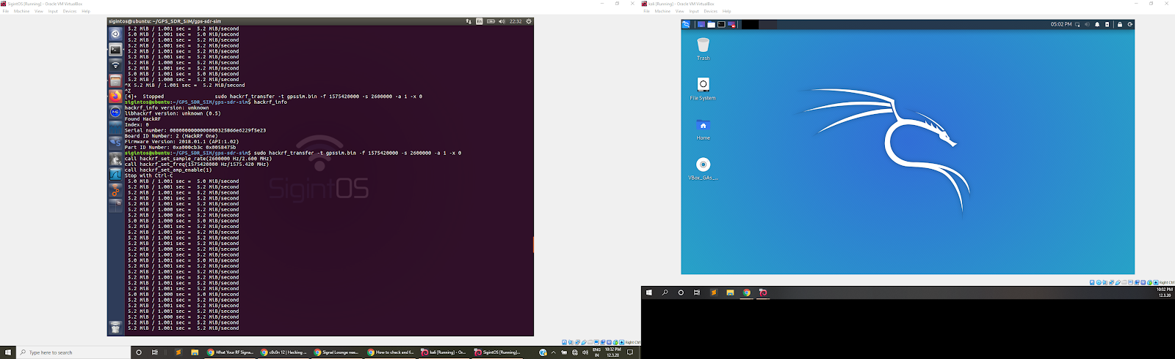
GPS Spoofing
https://cddis.nasa.gov/archive/gnss/data/daily/
Notes:
GPS-SDR-SIM generates GPS baseband signal data streams, which can be converted to RF using software-defined radio (SDR) platforms, such as ADALM-Pluto, bladeRF, HackRF, and USRP.
The user specifies the GPS satellite constellation through a GPS broadcast ephemeris file. The daily GPS broadcast ephemeris file (brdc) is a merge of the individual site navigation files into one. The archive for the daily file can be downloaded from: (https://cddis.nasa.gov/archive/gnss/data/daily/). Access to this site requires registration, which is free.
These files are then used to generate the simulated pseudorange and Doppler for the GPS satellites in view. This simulated range data is then used to generate the digitized I/Q samples for the GPS signal.
------
Each GPS satellite continuously transmits a radio signal containing the current time and data about its position. Since the speed of radio waves is constant and independent of the satellite speed, the time delay between when the satellite transmits a signal and the receiver receives it is proportional to the distance from the satellite to the receiver. A GPS receiver monitors multiple satellites and solves equations to determine the precise position of the receiver and its deviation from true time. At a minimum, four satellites must be in view of the receiver for it to compute four unknown quantities

Slide 40
Start → Motivation (1 min)
Specification (1 min)
Components → Develop Diagram for System (House/RFID/Wifi Control) (3 min)
Snapshots of code/hardware
Datasets for control vectors (IR/Wifi/RFID) (very brief) (1 min)
Normal Functionality of the House (1.5 min)
Showcase RFID, Occupancy-based lighting, (maybe) garage door control w/ IR
Threat Modeling: (2.5 minutes)
Attack Demo: (3-4 min)
Mitigations (1-2 min)
Concepts Covered in Class (1-2 min)
Security, Finite State Machine Modeling, Temporal Logic Specification, Scheduling, Sensors and Actuators, Preemptive Priority-Based Scheduler

